Slide 1
UNCLOS and Law of the Sea
Shamshad Ahmad Khan, PhD

Slide 2
As discussed in the previous classes
Law of the Seas has evolved in phases
State practices of using the Sea (Customary International Law) transformed into the Law of Seas
https://www.youtube.com/watch?v=V6JIOAlIfNg
There had been three UN conventions on the Law of Sea, the most recent one was signed in 1982 and came into effect in 1994.
The 1982 convention divides Sea and air spaces over it into different zones

Slide 3
The 1982 Convention signed by more than 150 states
establishes a comprehensive legal framework for the regulation of all ocean space.
covers a diverse range of issues such as the offshore limits of national jurisdiction,
access to the seas, navigation, protection and preservation of the marine environment,
exploitation and conservation of living resources, exploitation of non-living resources, seabed mining, and scientific research.

Slide 4
In short (let us watch)
https://www.youtube.com/watch?v=qG3VCpLtJSM
https://www.youtube.com/watch?v=jkAb6u6qYoU

Slide 5
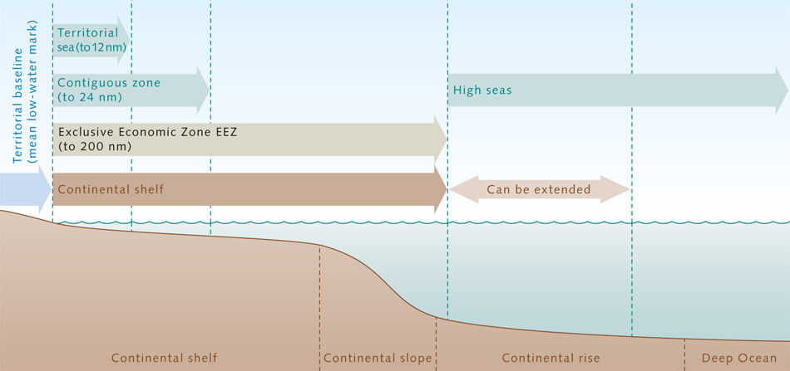
A quick look

Slide 6
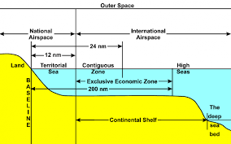
Territorial Sea
Territorial Sea - extends up to 12 nautical miles from the territorial sea baseline.
A coastal State has sovereignty over this zone (just as it has sovereignty over its land territory)
It also has sovereignty over the airspace above Territorial Sea.
In the territorial sea, this sovereignty is subject to the right of innocent passage of foreign vessels.

Slide 7
Contiguous Zone
Contiguous Zone is the next 12 nautical miles beyond the territorial sea.
In this zone a coastal State may exercise control over customs, immigration and quarantine matters.

Slide 8
Exclusive Economic Zone
EEZ extends beyond the territorial sea and upto 200 nautical miles from the Territorial Base line.
In this zone, a coastal State has sovereign rights for the purposes of exploring and exploiting, conserving and managing the natural resources (living or non-living) of the water column, seabed and subsoil.
However, it cannot exercise full sovereignty.

Slide 9
Continental Shelf
Continental Shelf - extends beyond the territorial sea to 200 nautical miles from the Base line, or beyond that to the outer edge of the continental margin as defined in Article 76 of UNCLOS.
In Continental Shelf , a coastal State has sovereign rights for the purposes of exploring and exploiting mineral and other non-living resources of the seabed and subsoil.

Slide 10
High seas
High seas - the area beyond national jurisdiction in which all States have freedom of navigation and overflight.
They have freedom to lay cables/pipelines, construct artificial islands/installations, fish and conduct scientific research.

Slide 11
The Area
The Area - seabed and subsoil beyond national jurisdiction. The Area and its non-living 'mineral' resources are the common heritage of mankind and are managed on behalf of mankind by the International Seabed Authority - a body established under UNCLOS

Slide 12
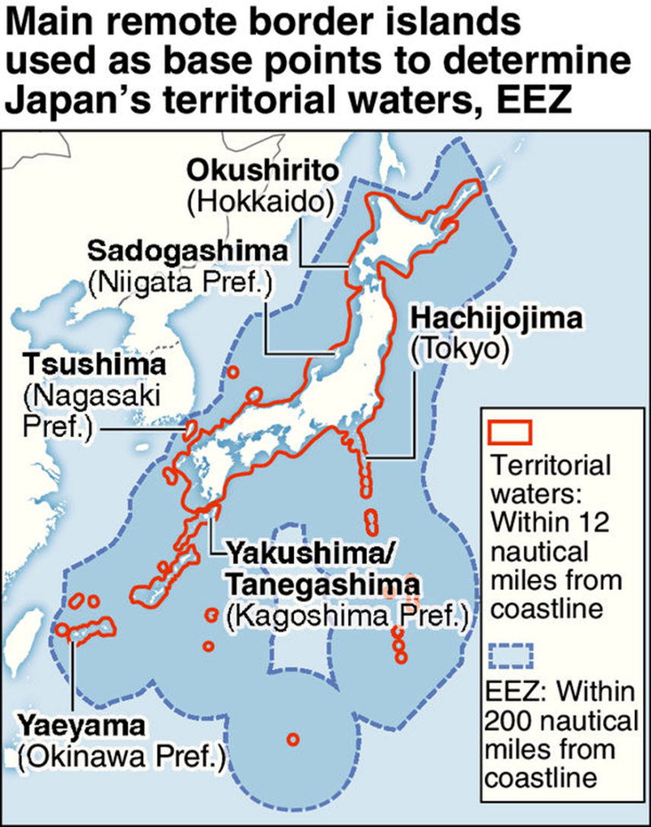
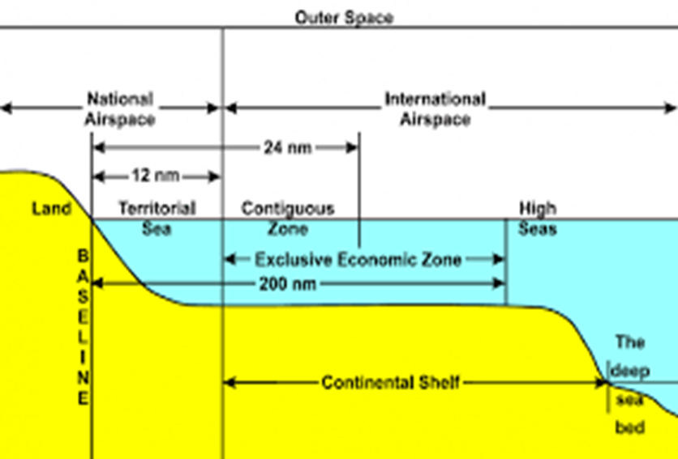
How big Japan looks after 1982 UNCLOS

Slide 13
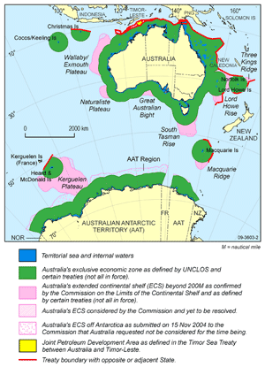
UNCLOS: A case study of Australia
Please have a look at the Australian map to understand its Territorial Sea and EEZ.
The Island can increase the EEZ area of the country.
The more islands it has the more EEZ area it can have.
That is way the countries around the world do not give up sovereignty over the island and contest sovereignty over it.

Slide 14
UNCLOS in action
Let us watch the documentary.
(south China Sea)
https://www.youtube.com/watch?v=BHCkZbBwFyM
(East China Sea)
https://www.youtube.com/watch?v=yIl79V4YGqI

